Slide 1
Grade Analysis and Prediction By: David Curren

Slide 2
Table of Contents
Dataset Discussion
Data Population Characterization
Feature Analysis
Model Development

Slide 3
Dataset Discussion
1

Slide 4
Considered Datasets
Microsoft Malware Dataset
Reason for different dataset: Wanted to choose a different dataset from others
Wildfire Dataset
Reason for different dataset: Complex dataset representation, issues with some attributes
Water Potability Dataset
Reason for different dataset: Illogical values for different features with no correlation

Slide 5
Chosen Dataset: Student Grades
Background:
Student grade performance data measured at three points throughout the year for two Portuguese secondary education schools.
Contains relevant factors that affect student success such as demographics, which was gathered via surveys.
Inspiration for Analysis:
Develop model for prediction to apply to student grades

Slide 6
Population Characterization
2

Slide 7
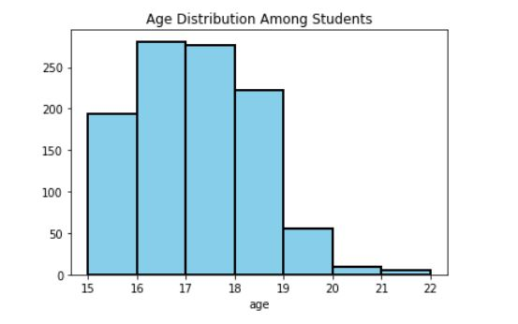
Student Characterization- Basic Information

Slide 8
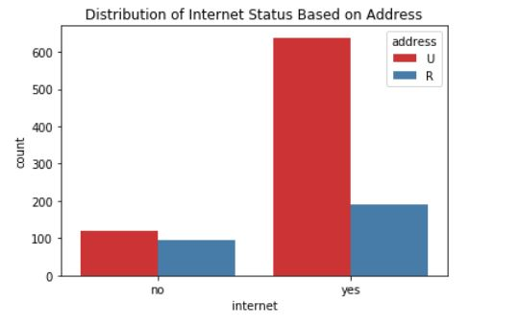
Student Characterization – Living Situation

Slide 9
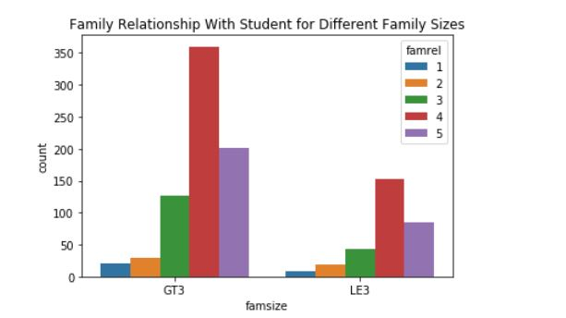
Student Characterization – Student Living Situation 2

Slide 10
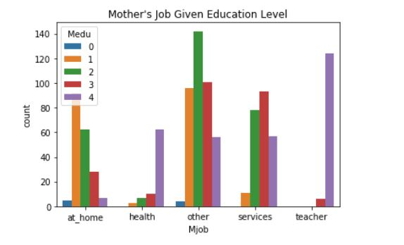
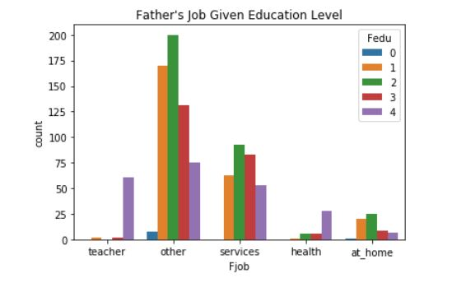
Student Characterization- Student Living Situation 3

Slide 11
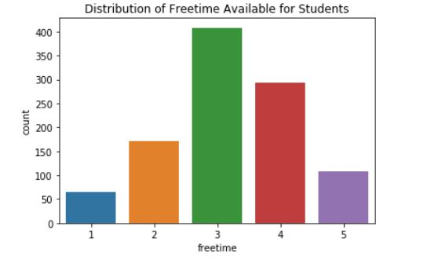
Student Characterization – Time Usage

Slide 12
Feature Analysis with Target Feature (Grades)
3

Slide 13
Feature Areas of Interest
School System
Reason: Different school support systems at different schools
Student Health
Reason: Often health issues affect performance, lead to absences
Social Life
Reason: School/life balance
Family Dynamics
Reason: Considering family size, family support would impact time/resources parents can give to their children.

Slide 14
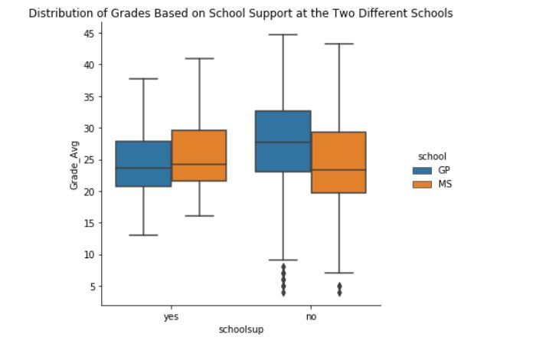
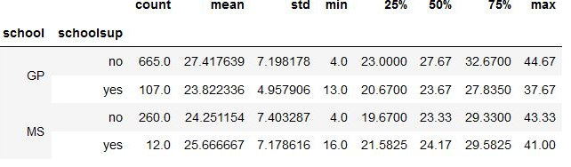
Feature: School System

Slide 15
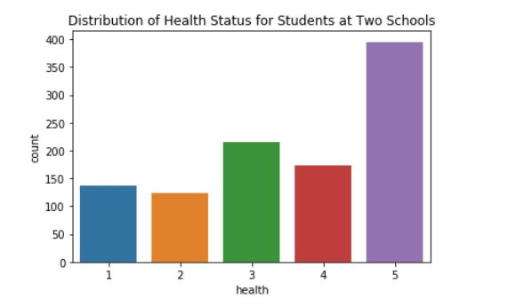
Feature: Health

Slide 16
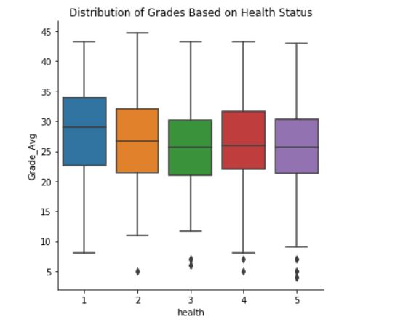
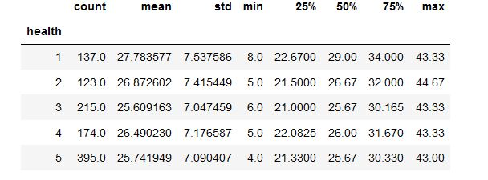
Feature: Health (continued)

Slide 17
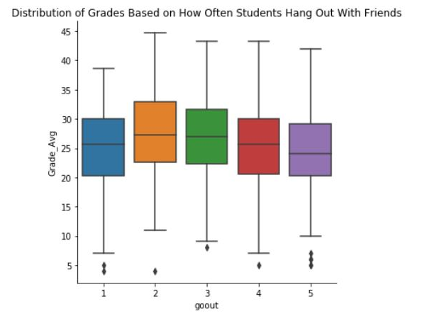
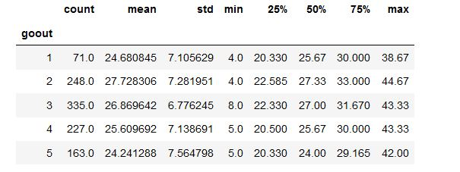
Feature: Hanging Out With Friends

Slide 18
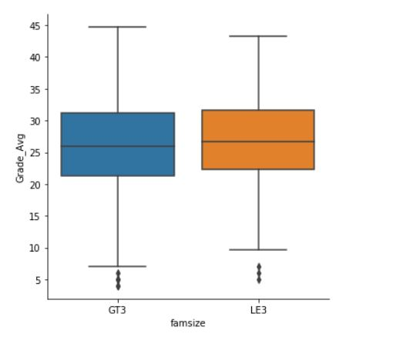
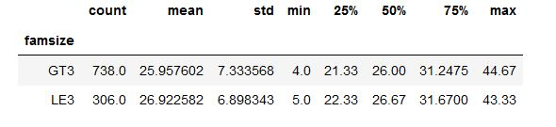
Feature: Family Size

Slide 19
Model Development
4

Slide 20
Model Considerations (Classification Algorithms)
Logistic Regression
Consideration: Only used for binary classification (there are 5 classes for this data)
KNN
Consideration: Curse of dimensionality
Naïve Bayes
Consideration: Does not work well with high feature count, does not produce best results
Selected Model: Decision Trees
Reason: Works well with high feature count, but can overfit the data

Slide 21
Steps to Develop Decision Tree Model
Adjust features to represent numerical values that are representative of survey results
Classify grades based on standard letter grading scale
Remove features of high correlation
Split data into train and test sets

Slide 22
Parameter Observations
Max_leaf_nodes
Lower max leaf node count produced higher accuracy
Results seemed stable when setting parameter to the number of features
Max_depth
Lower values produced higher accuracy
If set too high, the accuracy goes down, especially when max_leaf_nodes is also high.
Most stable results around 10-15
Max_features
Best results with max_features set to sqrt.

Slide 23
Thank You!
ANY QUESTIONS?
Data:
https://www.kaggle.com/dipam7/student-grade-prediction
Research Paper: http://www3.dsi.uminho.pt/pcortez/student.pdf
Code: https://github.com/currend/Student-Grade-Project

